Slide 1
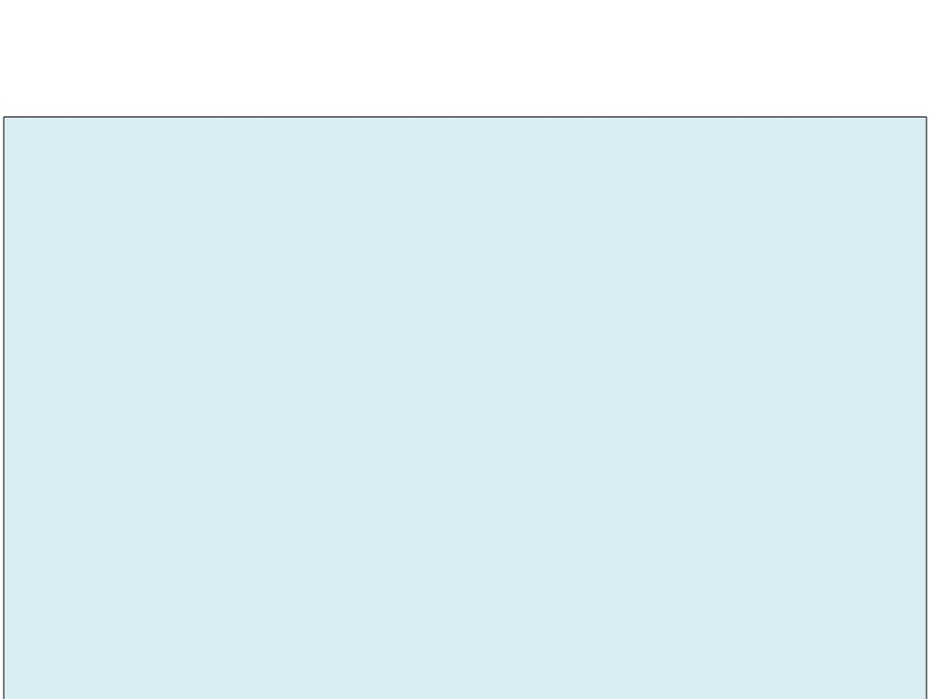
Chapter 11 - Graph
• A Graph G consists of a set V, whose members are called the vertices of G, together with a set E of pairs of distinct vertices from V.
• The pairs in E are called the edges of G.
• If the pairs are unordered, G is called an undirected graph or a graph. Otherwise, G is called a directed graph or a digraph.
• Two vertices in an undirected graph are called adjacent if there is an edge from the first to the second.

Slide 2
Chapter 11 - Graph
• A path is a sequence of distinct vertices, each adjacent to the next.
• A cycle is a path containing at least three vertices such that the last vertex on the path is adjacent to the first.
• A graph is called connected if there is a path from any vertex to any other vertex.
• A free tree is defined as a connected undirected graph with no cycles.

Slide 3
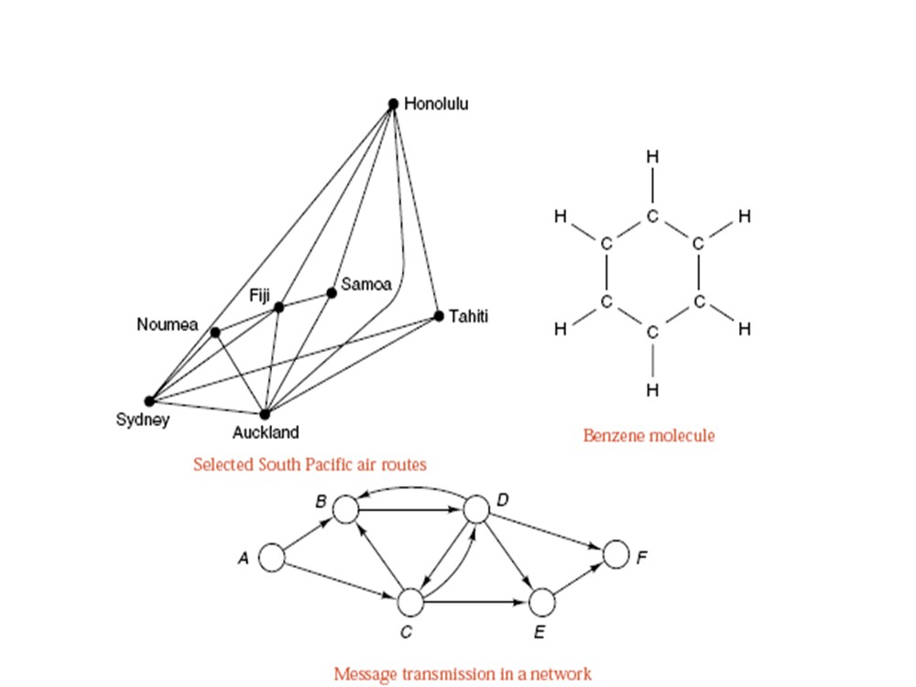
Examples of Graph

Slide 4
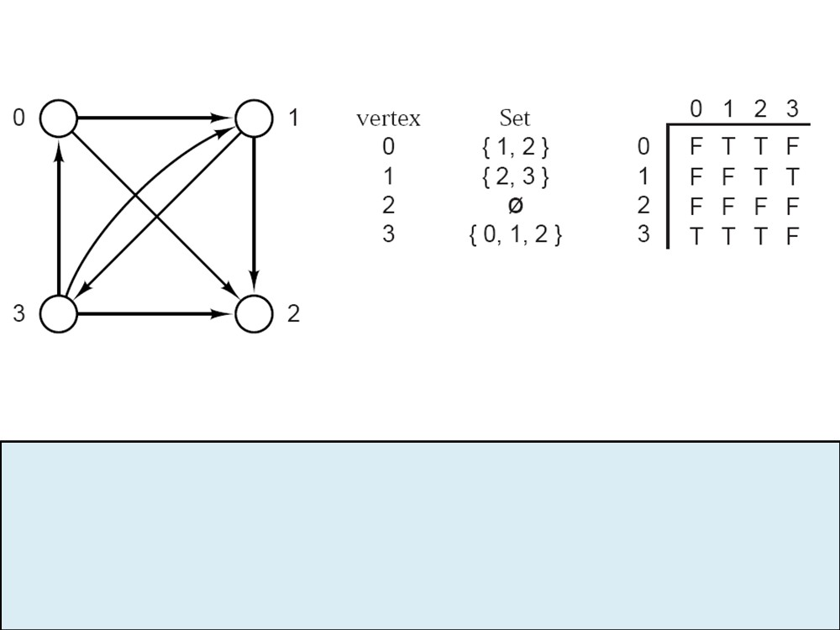
Digraph as an adjacency table
Directed graph
Adjacency set
Adjacency table
Digraph
count <integer>
// Number of vertices
edge <array of <array of <boolean> > >
// Adjacency table
End Digraph

Slide 5
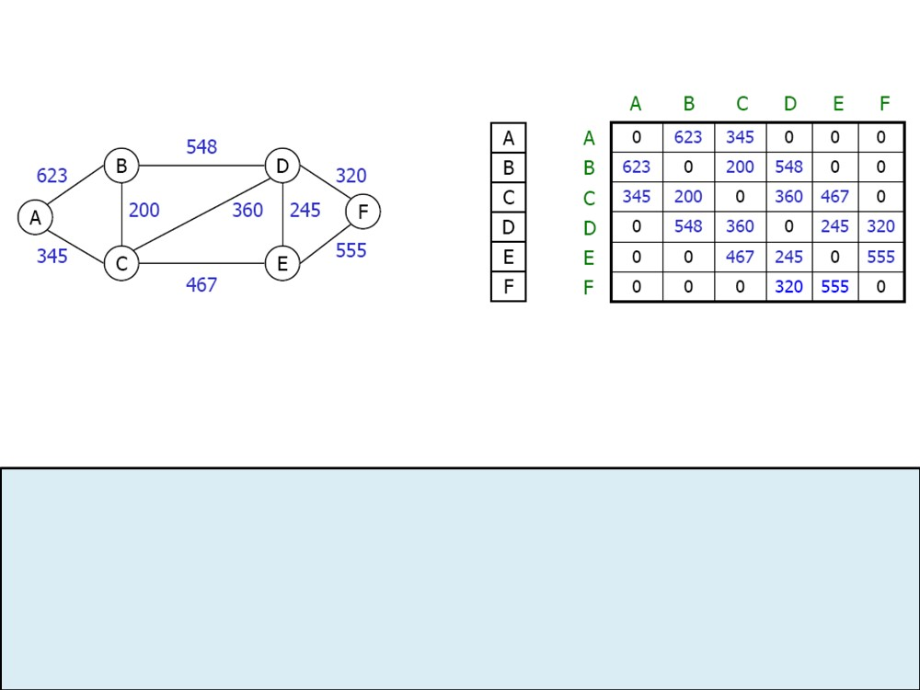
Weighted-graph as an adjacency table
Weighted-graph
vertex vector
adjacency table
WeightedGraph
count <integer>
// Number of vertices
edge<array of<array of<WeightType>>>
// Adjacency table
End WeightedGraph

Slide 6
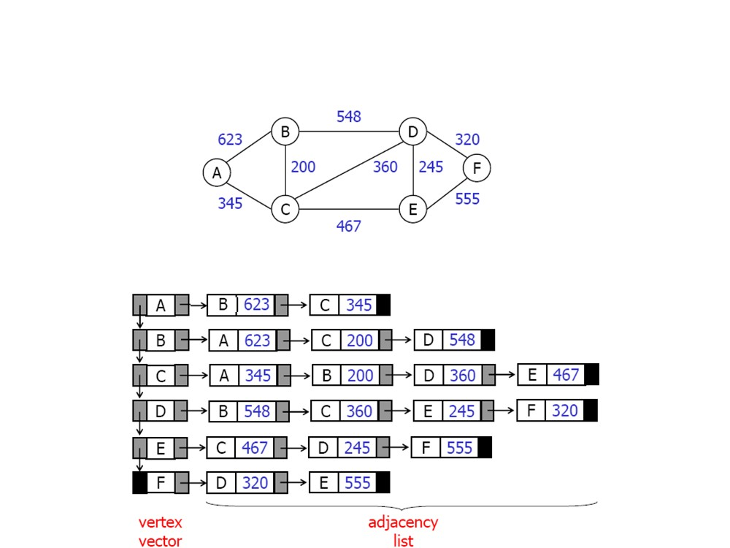
Weighted-graph as an adjacency list

Slide 7
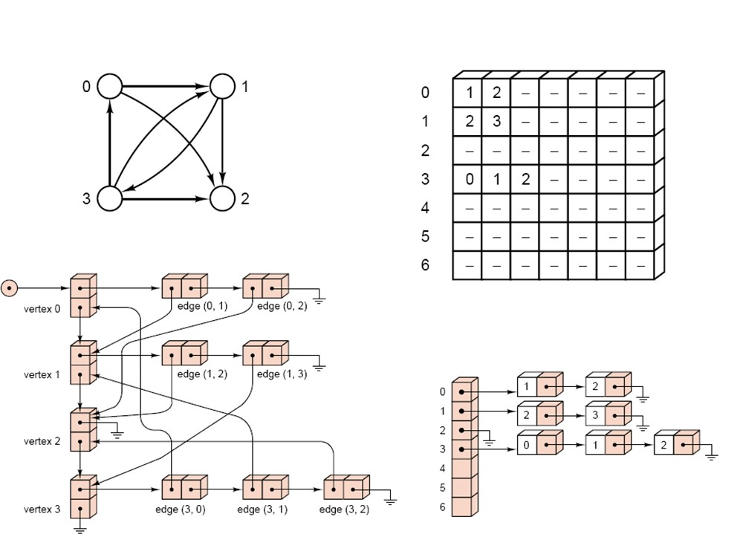
Digraph as an adjacency list
Directed graph
contiguous structure
linked structure
mixed structure

Slide 8
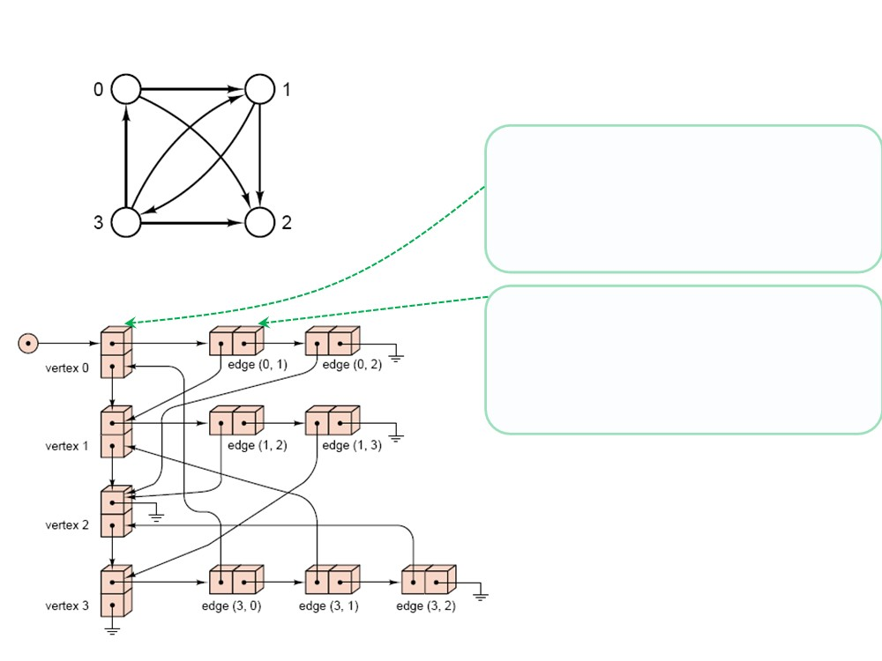
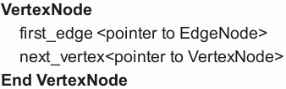
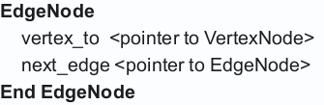
Digraph as an adjacency list (not using List ADT)
V
Directed graph
first_vertex
DiGraph
first_vertex <pointer to VertexNode> End DiGraph
linked structure

Slide 9
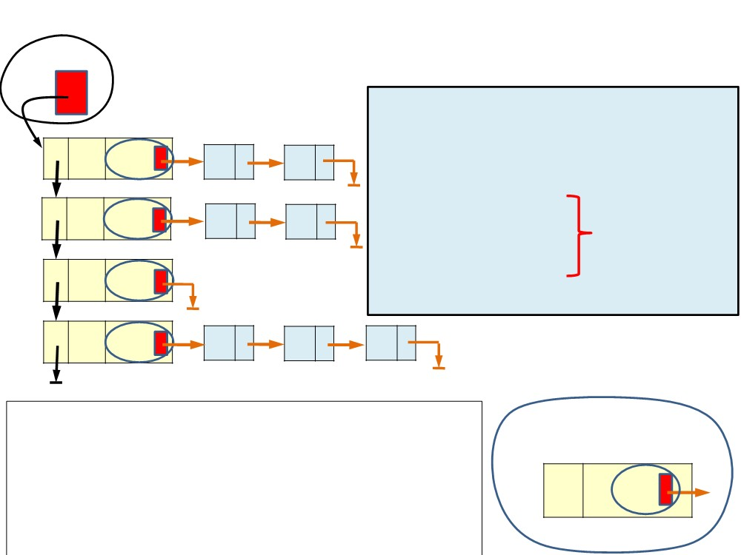
Digraph as an adjacency list (using List ADT)
head
digraph
GraphNode
vertex <VertexType> // (key field) adjVertex<LinkedList of< VertexType >> indegree <int> are hidden
0
head
1 2
1
head
2 3
outdegree <int> from the
2
isMarked <boolean> image below
head
End GraphNode
3
head
0 1
2
GraphNode
ADT List is linked list:
vertex adjVertex
DiGraph digraph <LinkedList<of<GraphNode>>
2 head
End DiGraph

Slide 10
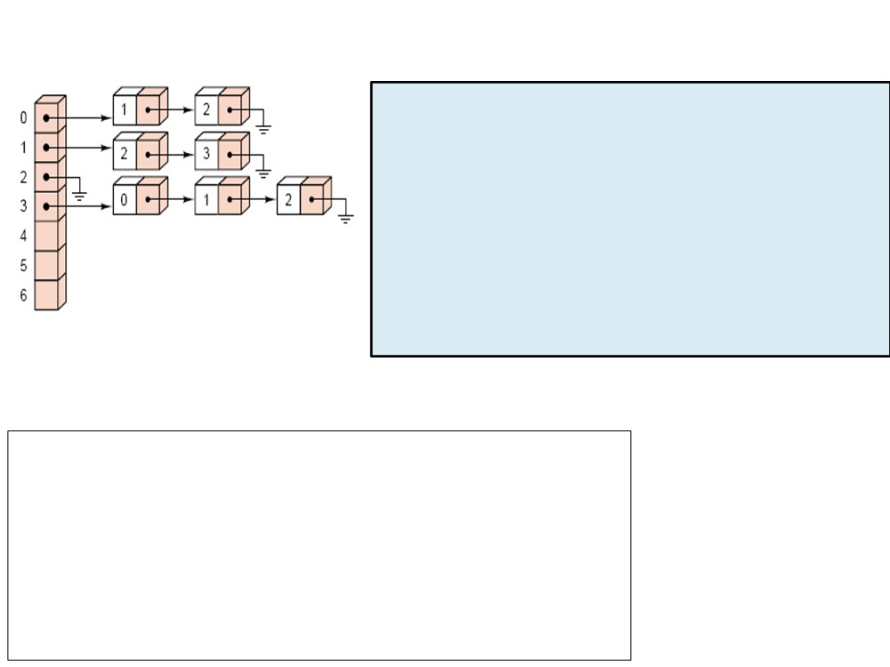
Digraph as an adjacency list (using List ADT)
GraphNode
vertex <VertexType> // (key field)
adjVertex<LinkedList of< VertexType >> indegree <int>
outdegree <int>
isMarked <boolean> End GraphNode
mixed list
ADT List is contiguous list:
DiGraph
digraph <ContiguousList<of<GraphNode>> End DiGraph

Slide 11
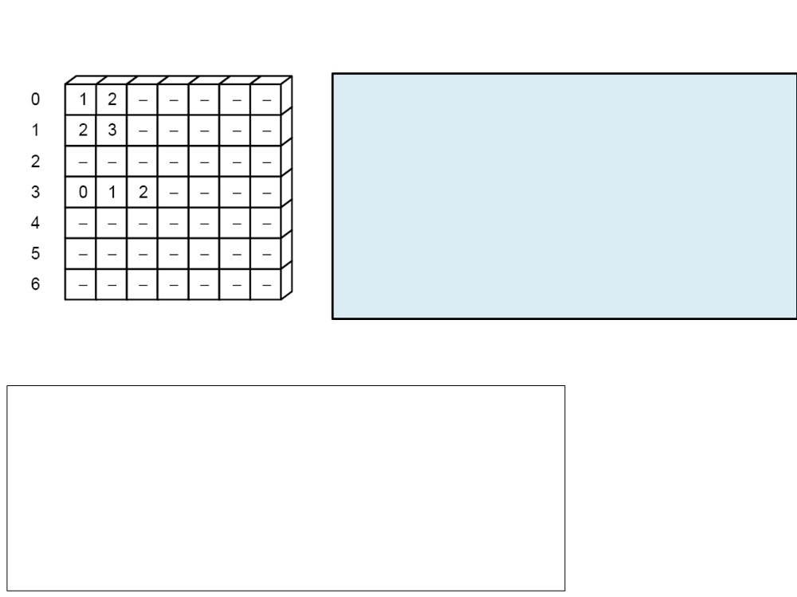
Digraph as an adjacency list (using List ADT)
GraphNode
vertex <VertexType> // (key field)
adjVertex<ContiguousList of< VertexType >> indegree <int>
outdegree <int>
isMarked <boolean> End GraphNode
contiguous list
ADT List is contiguous list:
DiGraph
digraph <ContiguousList<of<GraphNode>> End DiGraph

Slide 12
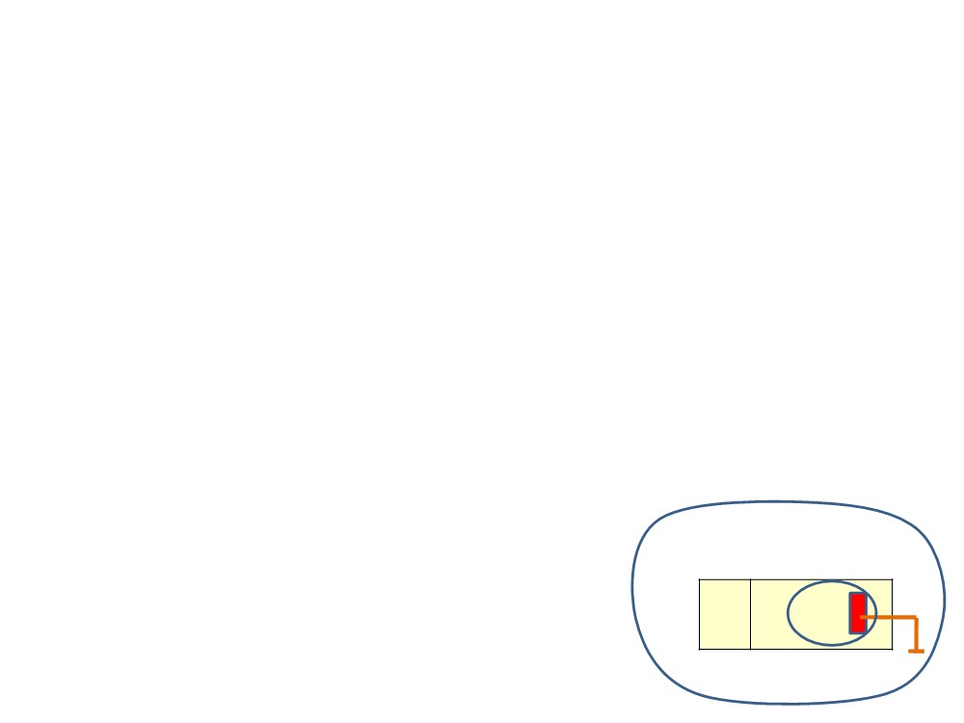
GraphNode
<void> GraphNode() // constructor of GraphNode
1. indegree = 0
2. outdegree = 0
3. adjVertex.clear() // By default, constructor of adjVertex made it empty.
End GraphNode
GraphNode
vertex adjVertex
head

Slide 13

Operations for Digraph
➢Insert Vertex
➢ Delete Vertex ➢Insert edge ➢ Delete edge ➢ Traverse

Slide 14
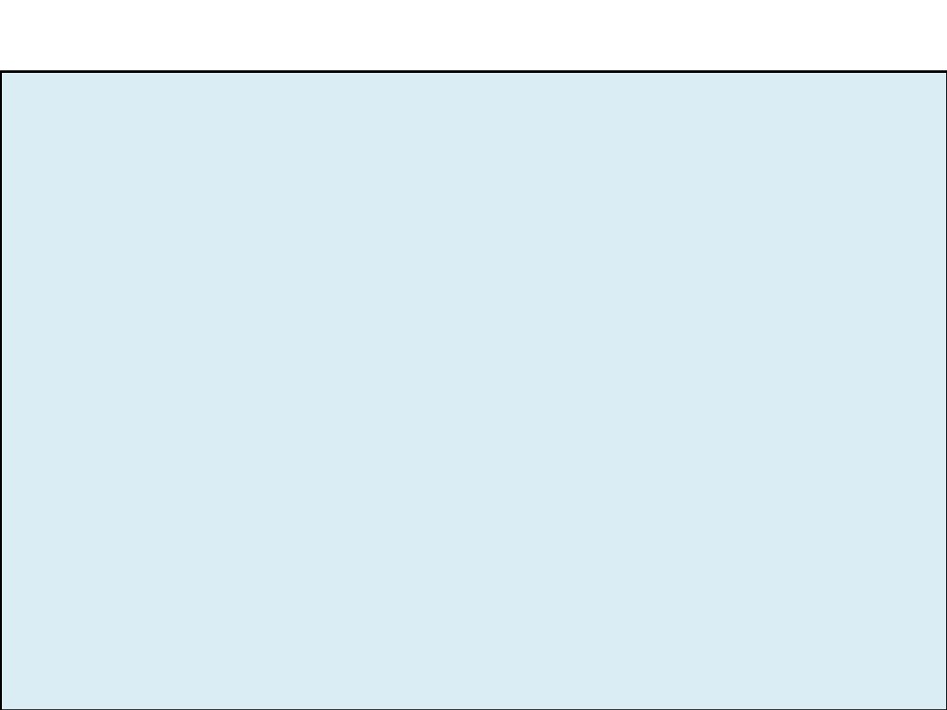
Digraph
Digraph
private:
digraph <List of <GraphNode> > // using of List ADT .
<void> Remove_EdgesToVertex(val VertexTo <VertexType>)
public:
<ErrorCode> InsertVertex (val newVertex <VertexType>) <ErrorCode> DeleteVertex (val Vertex <VertexType>) <ErrorCode> InsertEdge (val VertexFrom <VertexType>, val VertexTo <VertexType>)
<ErrorCode> DeleteEdge (val VertexFrom <VertexType>, val VertexTo <VertexType>)
// Other methods for Graph Traversal. End Digraph

Slide 15
Methods of List ADT
Methods of Digraph will use these methods of List ADT:
<ErrorCode> Insert (val DataIn <DataType>)
// (success, overflow)
<ErrorCode> Search (ref DataOut <DataType>)
// (found, notFound)
<ErrorCode> Remove (ref DataOut <DataType>) // (success , notFound) <ErrorCode> Retrieve (ref DataOut <DataType>) // (success , notFound) <ErrorCode> Retrieve (ref DataOut <DataType>, position <int>)
// (success , range_error)
<ErrorCode> Replace (val DataIn <DataType>, position <int>)
// (success, range_error)
<ErrorCode> Replace (val DataIn <DataType>, val DataOut <DataType>) // (success, notFound)
<boolean> isFull()
<boolean> isEmpty() <integer> Size()

Slide 16
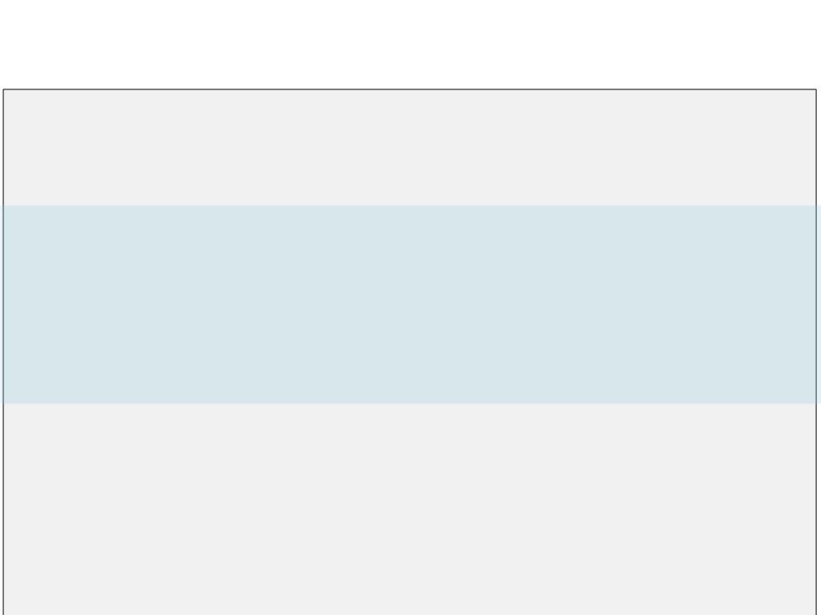
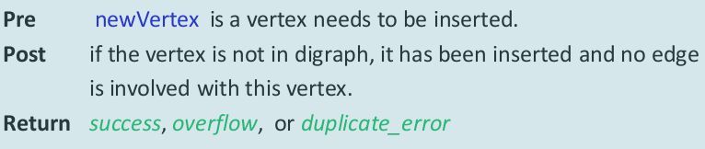
Insert New Vertex into Digraph
<ErrorCode> InsertVertex (val newVertex <VertexType>)
Inserts new vertex into digraph.

Slide 17
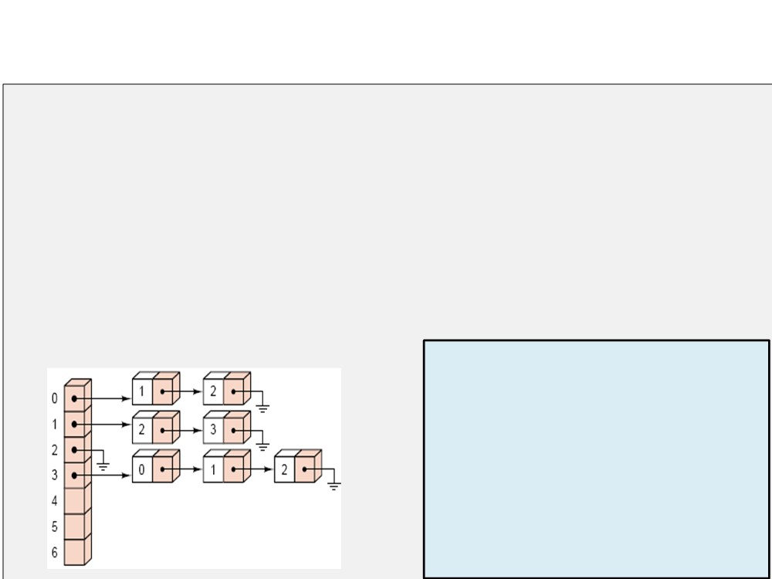
Insert New Vertex into Digraph
<ErrorCode> InsertVertex (val newVertex <VertexType>)
1. DataOut.vertex = newVertex
2. if (digraph.Search(DataOut) = success)
1. return duplicate_error
3. else
1. return digraph.Insert(DataOut) // success or overflow End InsertVertex
GraphNode
vertex <VertexType> // (key field) adjVertex<List of< VertexType >> indegree <int>
outdegree <int>
isMarked <boolean> End GraphNode

Slide 18
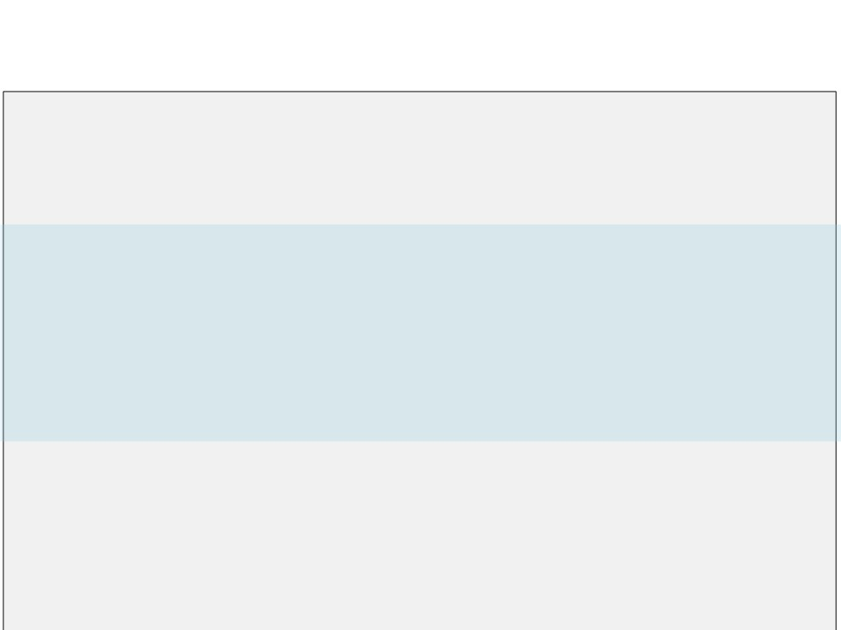
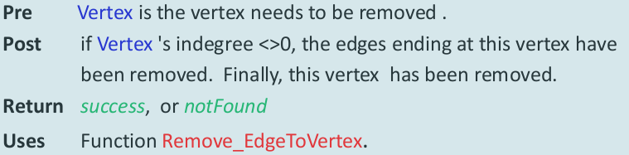
Delete Vertex from Digraph
<ErrorCode> DeleteVertex (val Vertex <VertexType>)
Deletes an existing vertex.

Slide 19
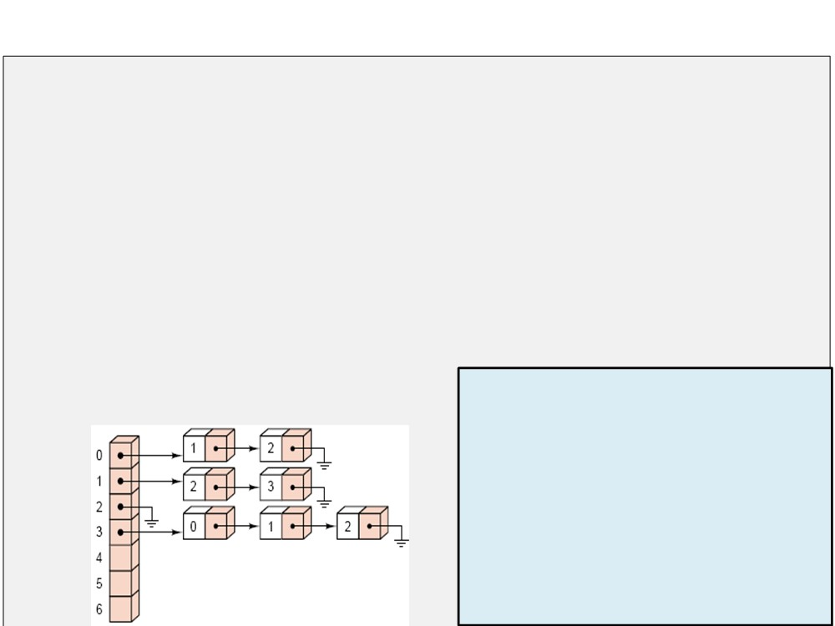
Delete Vertex from Digraph
<ErrorCode> DeleteVertex (val Vertex <VertexType>)
1.
DataOut.vertex = Vertex
2. if (digraph.Retrieve(DataOut) = success)
1. if (DataOut.indegree>0)
1.
digraph.Remove_EdgeToVertex(Vertex)
2.
digraph.Remove(DataOut)
3.
return success
3. else
1. return notFound End DeleteVertex
GraphNode
vertex <VertexType> // (key field) adjVertex<List of< VertexType >> indegree <int>
outdegree <int> isMarked <boolean> End GraphNode

Slide 20

Auxiliary function Remove all Edges to a Vertex
<void> Remove_EdgesToVertex(val VertexTo <VertexType>)
Removes all edges from any vertex to VertexTo if exist.
1.
position = 0
2. loop (digraph.Retrieve(DataFrom, position) = success)
1. if (DataFrom.outdegree>0)
1. if (DataFrom.adjVertex.Remove(VertexTo) = success)
1.
DataFrom.outdegree = DataFrom.outdegree - 1
2.
digraph.Replace(DataFrom, position)
2.
position = position + 1
GraphNode
End Remove_EdgesToVertex
vertex <VertexType> // (key field)
adjVertex<List of< VertexType >>
indegree <int>
outdegree <int>
isMarked <boolean> End GraphNode

Slide 21
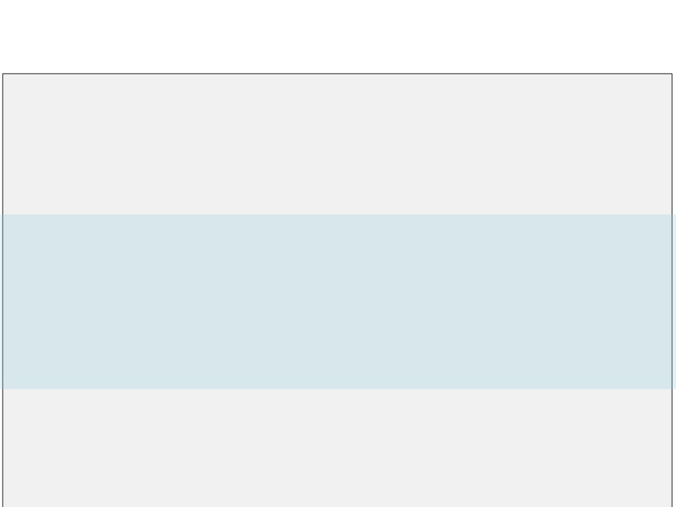
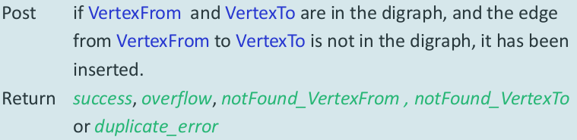
Insert new Edge into Digraph
<ErrorCode> InsertEdge (val VertexFrom<VertexType>, val VertexTo <VertexType>)
Inserts new edge into digraph.

Slide 22
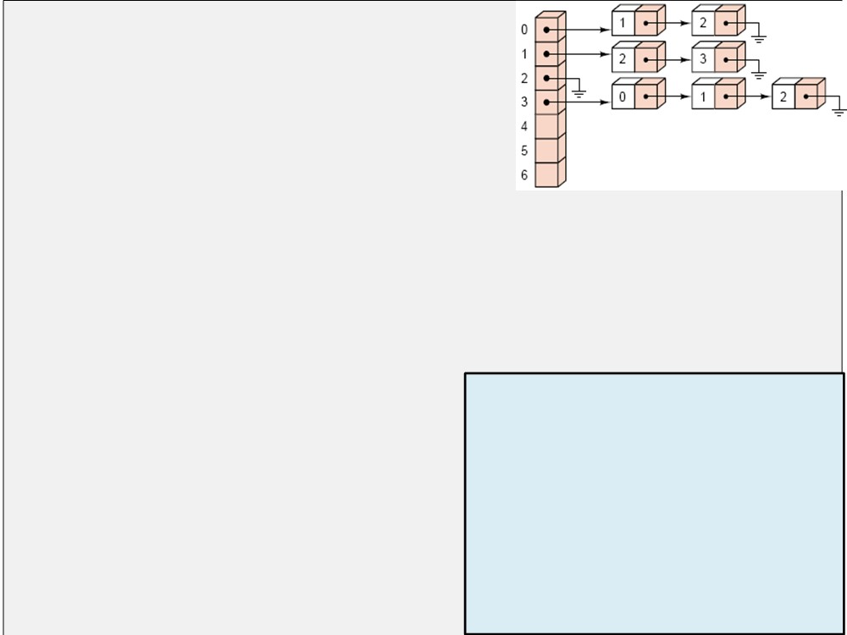
1.
DataFrom.vertex = VertexFrom
2.
DataTo.vertex = VertexTo
3. if ( digraph.Retrieve(DataFrom) = success )
1. if ( digraph.Retrieve(DataTo) = success )
1.
newData = DataFrom
2. if ( newData.adjVertex.Search(VertexTo) = found )
1.
return duplicate_error
3. if ( newData.adjVertex.Insert(VertexTo) = success )
1.
newData.outdegree = newData.outdegree +1 digraph.Replace(newData, DataFrom)
2.
3.
return success
4. else
GraphNode
vertex <VertexType> // (key field) adjVertex<List of< VertexType >> indegree <int>
1. return overflow
2. else
1. return notFound_VertexTo
outdegree <int> isMarked <boolean> End GraphNode
4. else
1. return notFound_VertexFrom End InsertEdge

Slide 23
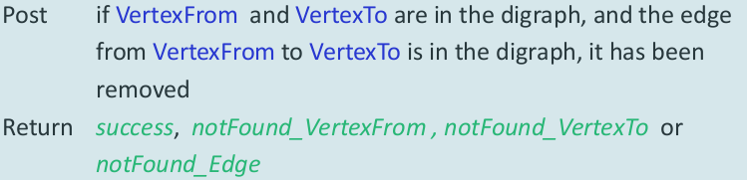
Delete Edge from Digraph
<ErrorCode> DeleteEdge (val VertexFrom <VertexType>, val VertexTo <VertexType>)
Deletes an existing edge in the digraph.

Slide 24
1.
DataFrom.vertex = VertexFrom
2.
DataTo.vertex = VertexTo
3. if ( digraph.Retrieve(DataFrom) = success )
1. if ( digraph.Retrieve(DataTo) = success )
1.
newData = DataFrom
2. if ( newData.adjVertex.Remove(VertexTo) = success )
1.
newData.outdegree = newData.outdegree -1
2.
digraph.Replace(newData, DataFrom)
3.
return success
3. else
1. return notFound_Edge
GraphNode
2. else
vertex <VertexType> // (key field) adjVertex<List of< VertexType >> indegree <int>
1. return notFound_VertexTo
4. else
1. return notFound_VertexFrom End DeleteEdge
outdegree <int> isMarked <boolean> End GraphNode

Slide 25
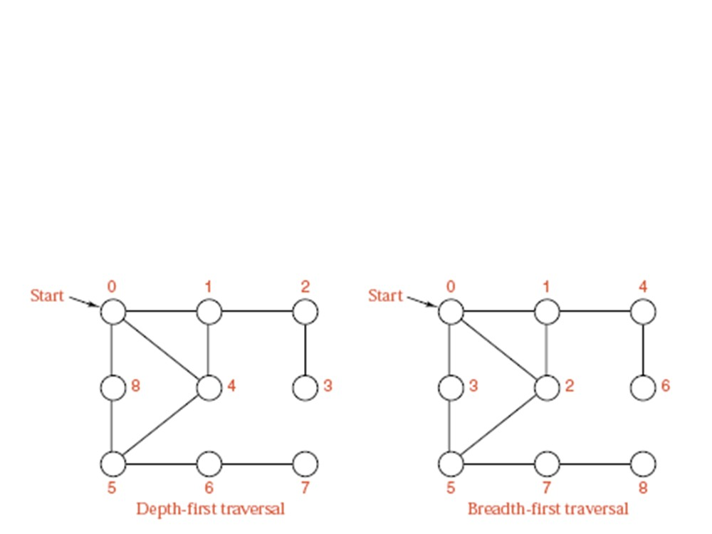
Graph Traversal
➢ Depth-first traversal: analogous to preorder traversal of an oredered tree.
➢ Breadth-first traversal: analogous to level-by-level traversal of an ordered tree.

Slide 26
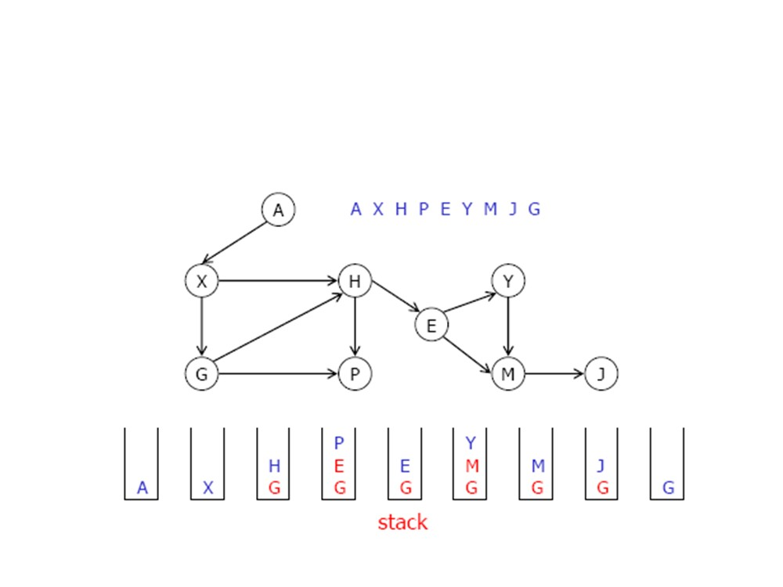
Depth-first traversal

Slide 27
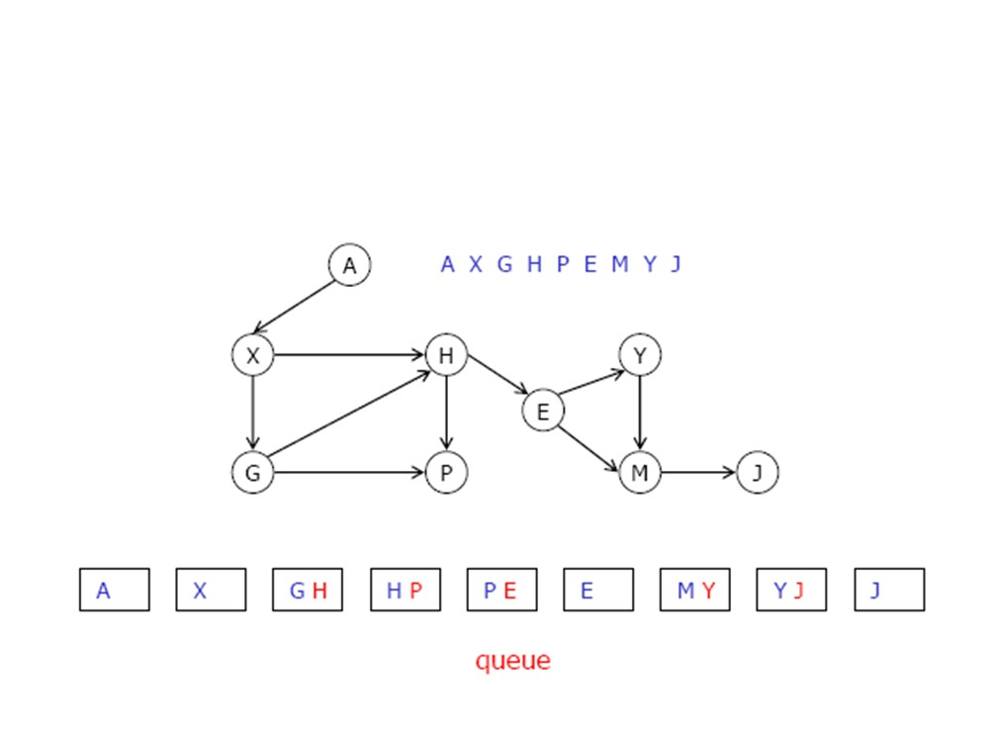
Breadth-first traversal

Slide 28
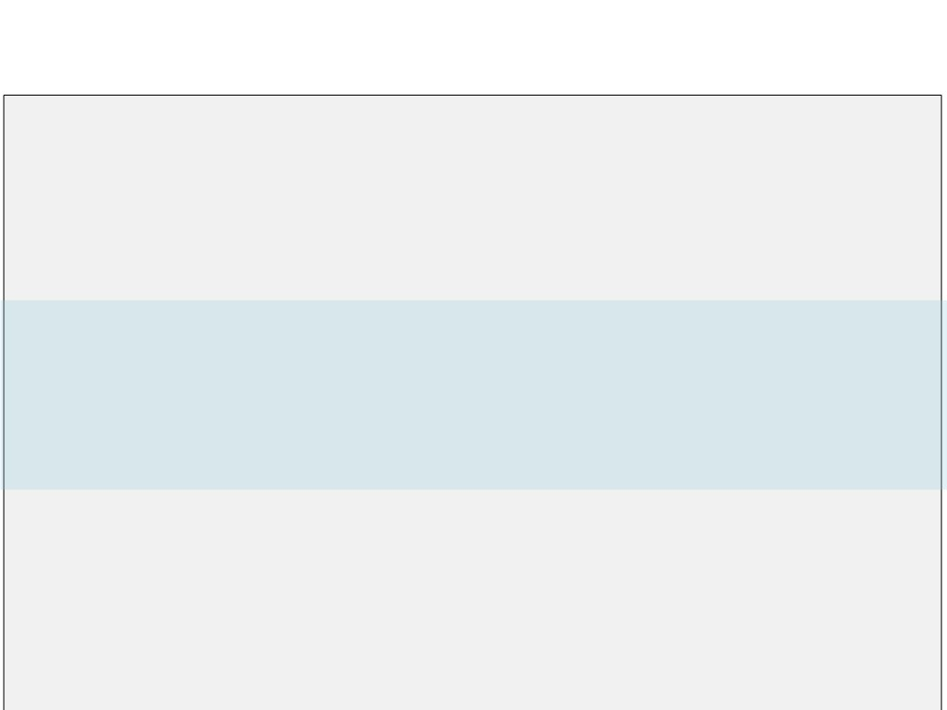
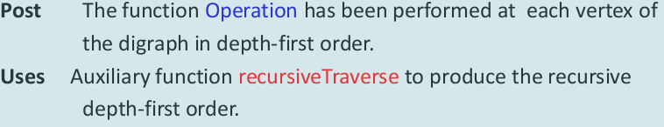
Depth-first traversal
<void> DepthFirst
(ref <void> Operation ( ref Data <DataType>))
Traverses the digraph in depth-first order.

Slide 29
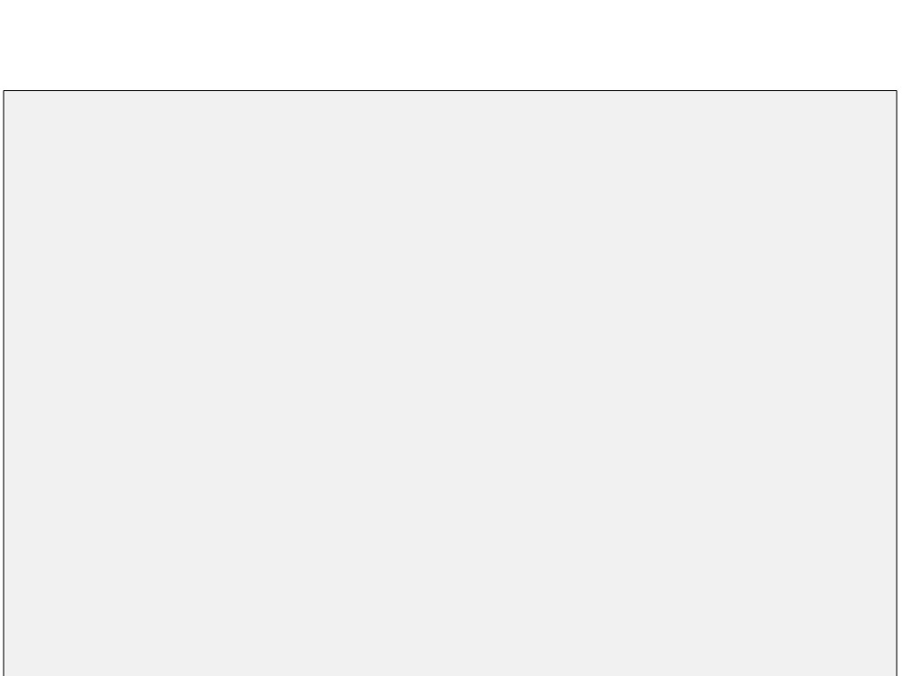
Depth-first traversal
<void> DepthFirst
(ref <void> Operation ( ref Data <DataType>))
1. loop (more vertex v in Digraph)
1. unmark (v)
2. loop (more vertex v in Digraph)
1. if (v is unmarked)
1. recursiveTraverse (v, Operation) End DepthFirst

Slide 30
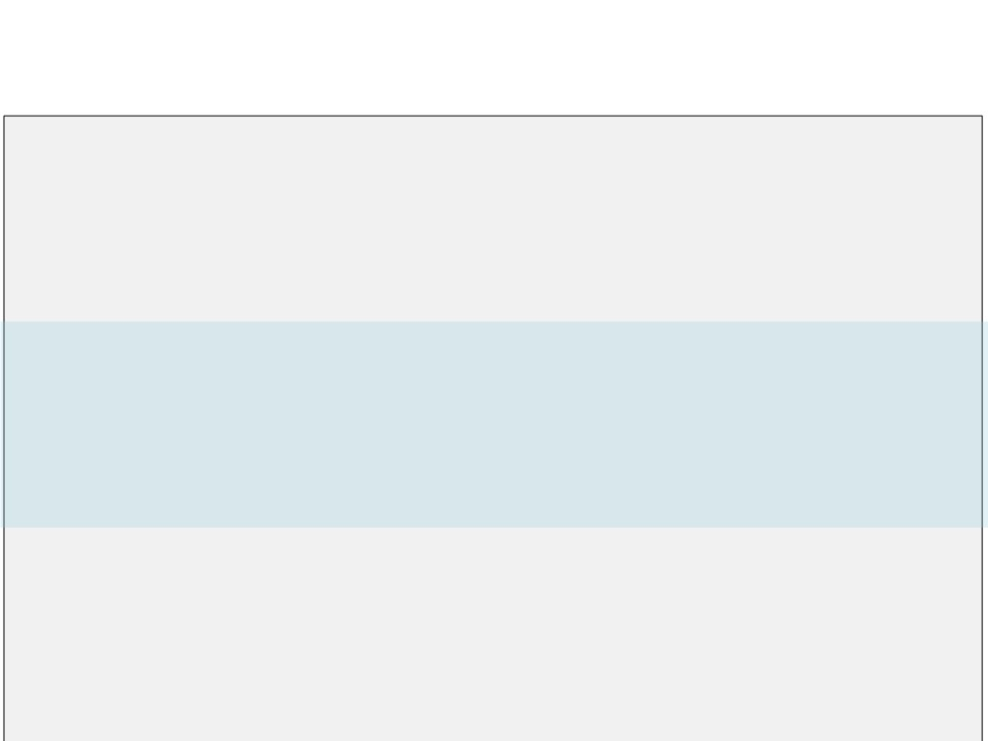
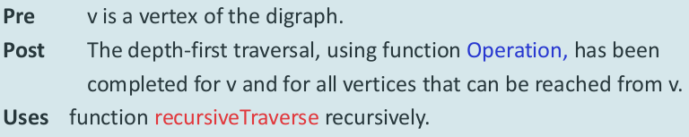
Depth-first traversal
<void> recursiveTraverse (ref v <VertexType>,
ref <void> Operation ( ref Data <DataType>) )
Traverses the digraph in depth-first order.

Slide 31
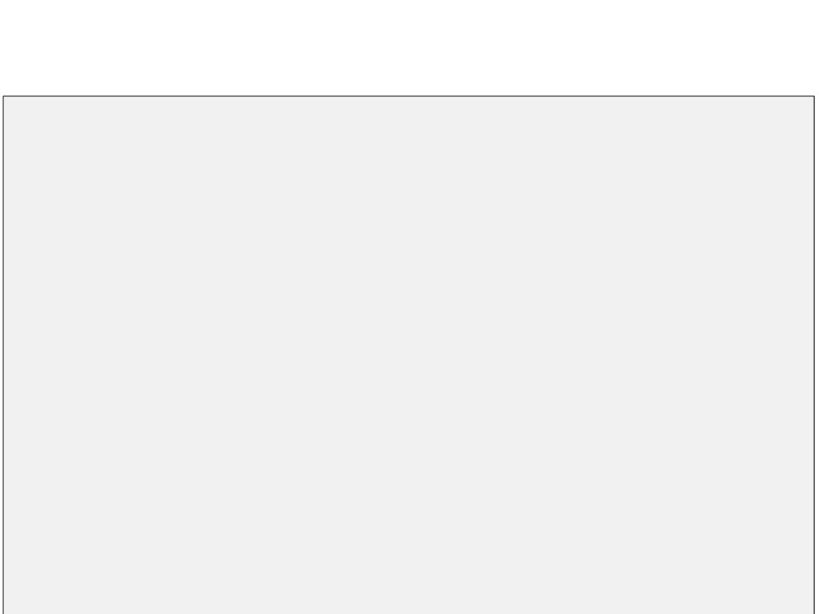
Depth-first traversal
<void> recursiveTraverse(ref v <VertexType>,
ref <void> Operation ( ref Data <DataType>) )
1. mark(v)
2. Operation(v)
3. loop (more vertex w adjacent to v)
1. if (vertex w is unmarked)
1. recursiveTraverse (w, Operation) End Traverse

Slide 32
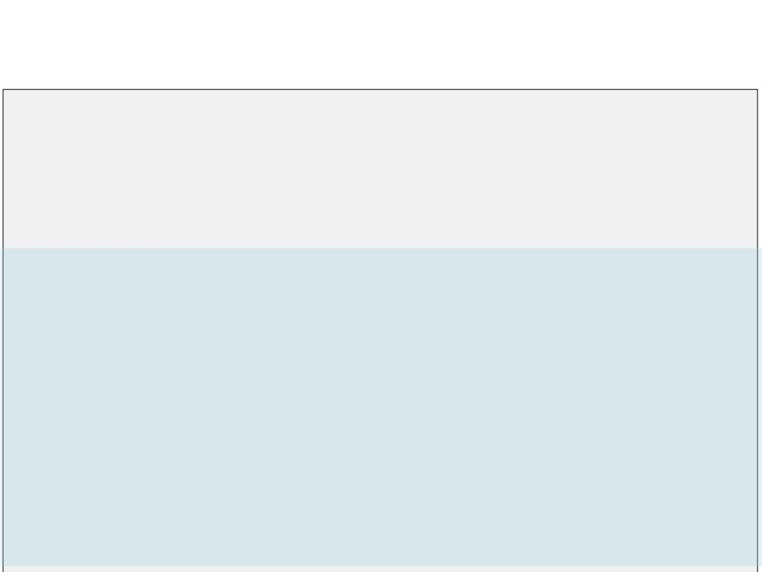
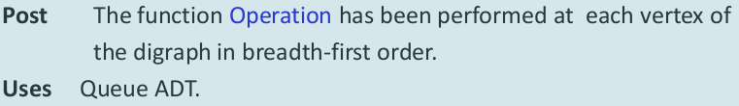
Breadth-first traversal
<void> BreadthFirst
(ref <void> Operation ( ref Data <DataType>) )
Traverses the digraph in breadth-first order.

Slide 33
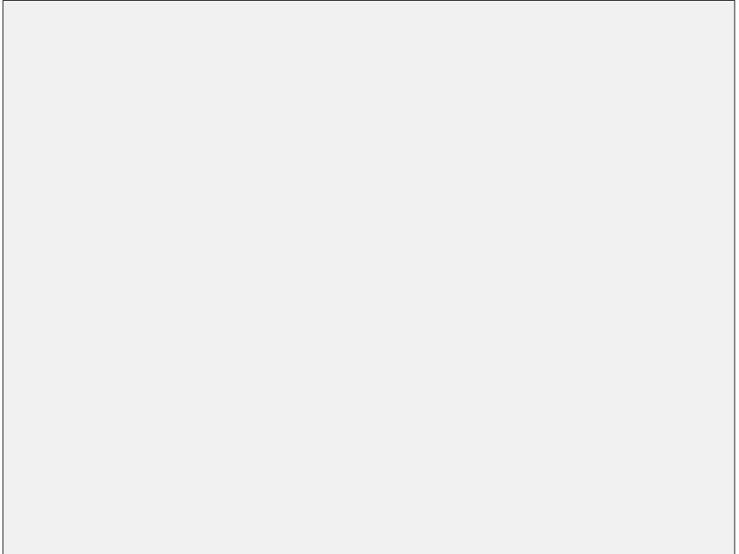
// BreadthFirst
1. queueObj <Queue>
2. loop (more vertex v in digraph)
1. unmark(v)
3. loop (more vertex v in Digraph)
1. if (vertex v is unmarked)
1. queueObj.EnQueue(v)
2. loop (NOT queueObj .isEmpty())
1. queueObj.QueueFront(w)
2. queueObj.DeQueue()
3. if (vertex w is unmarked)
1. mark(w)
2. Operation(w)
3. loop (more vertex x adjacent to w)
1. queueObj.EnQueue(x)
End BreadthFirst

Slide 34
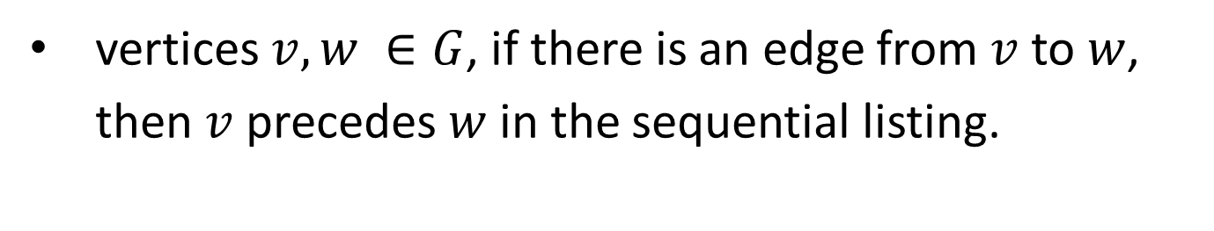
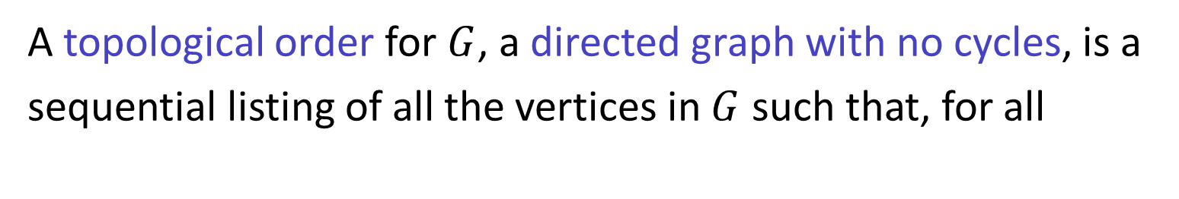
Topological Order
A topological order for $G$, a directed graph with no cycles, is a sequential listing of all the vertices in $G$ such that, for all
vertices $v, w ∈G$, if there is an edge from $v$ to $w$, then $v$ precedes $w$ in the sequential listing.

Slide 35
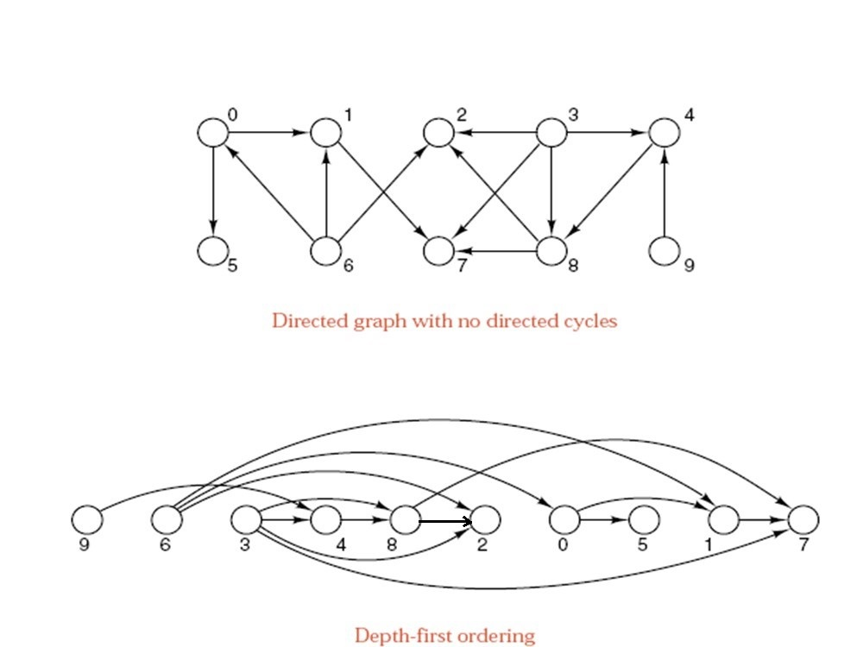
Topological Order

Slide 36
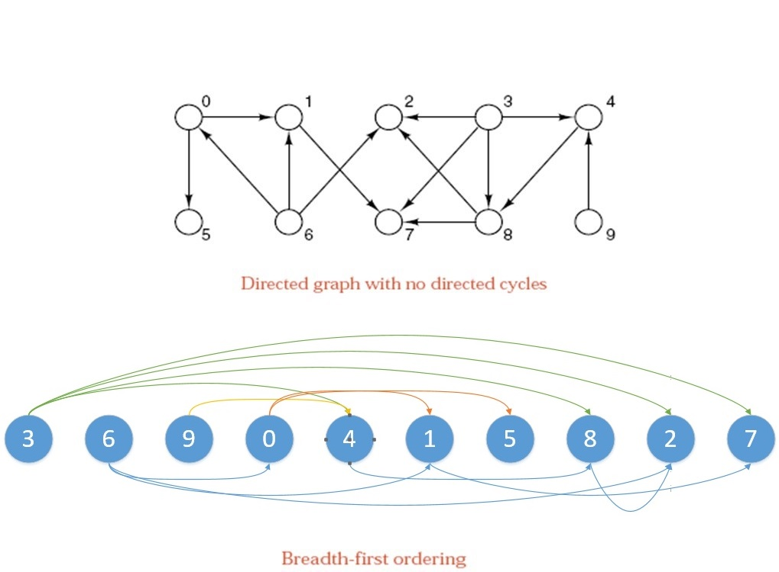
Topological Order

Slide 37
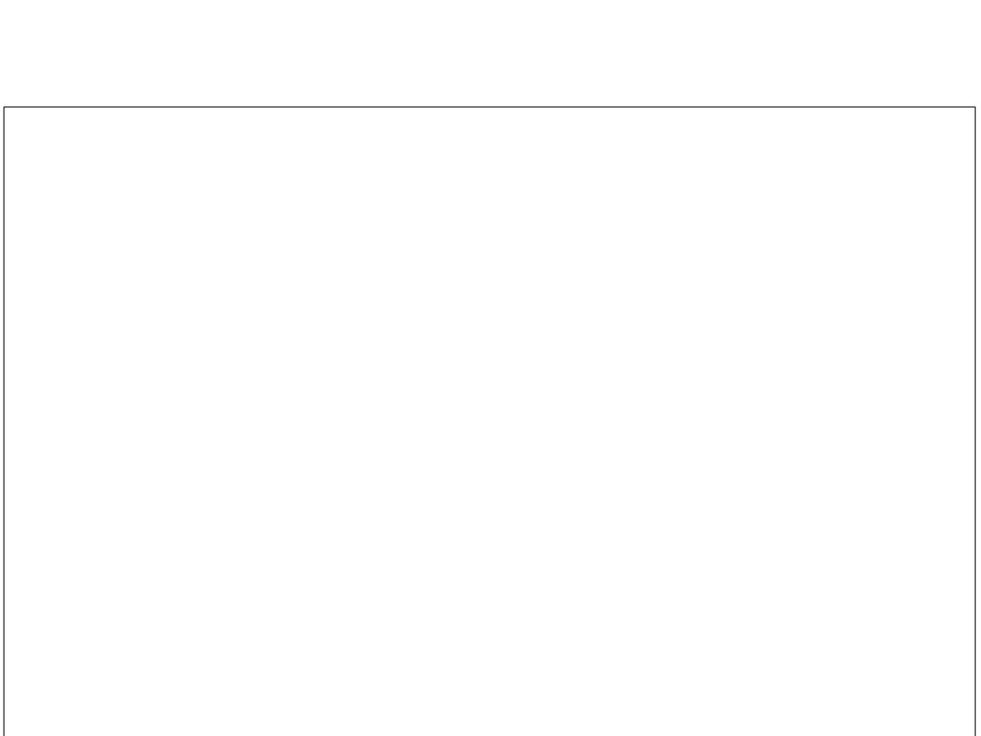
Applications of Topological Order
Topological order is used for:
➢ Courses available at a university,
• Vertices: course.
• Edges: (v,w), v is a prerequisite for w.
• A topological order is a listing of all the courses such that all perequisites for a course appear before it does.
➢ A glossary of technical terms: no term is used in a definition before it is itself defined.
➢ The topics in the textbook.

Slide 38
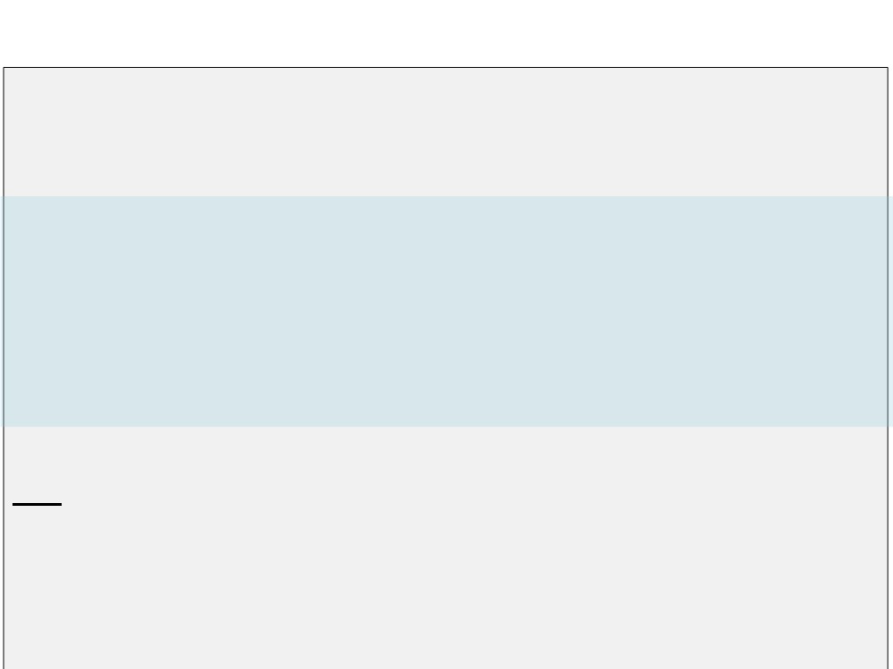
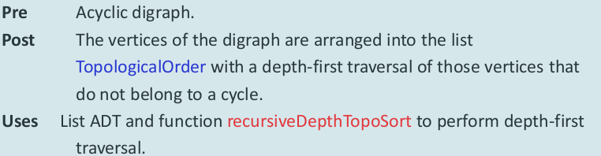
Topological Order
<void> DepthTopoSort (ref TopologicalOrder <List>)
Traverses the digraph in depth-first order and made a list of topological order of digraph's vertices.
Idea:
• Starts by finding a vertex that has no successors and place it last in the list.
• Repeatedly add vertices to the beginning of the list.
• By recursion, places all the successors of a vertex into the topological order.
• Then, place the vertex itself in a position before any of its successors.

Slide 39
Topological Order

Slide 40
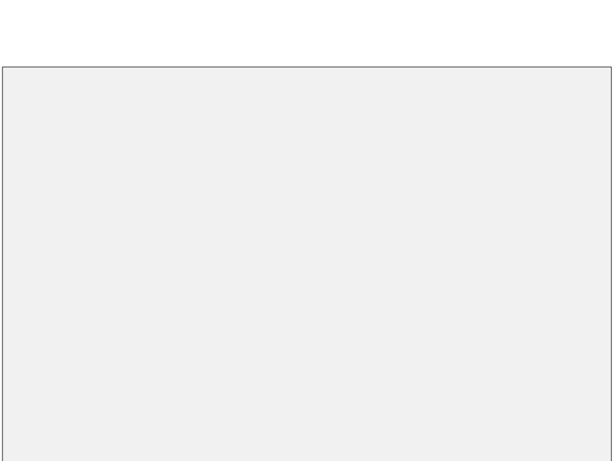
Topological Order
<void> DepthTopoSort (ref TopologicalOrder <List>)
1. loop (more vertex v in digraph)
1.
unmark(v)
2.
TopologicalOrder.clear()
3. loop (more vertex v in Digraph)
1. if (vertex v is unmarked)
1.
recursiveDepthTopoSort(v, TopologicalOrder)
End DepthTopoSort

Slide 41
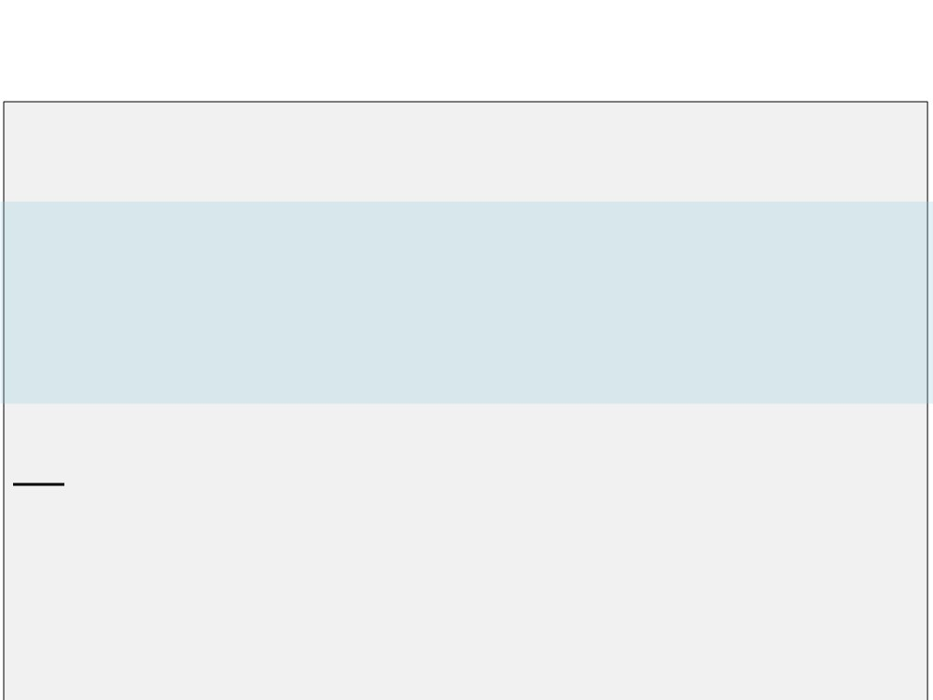
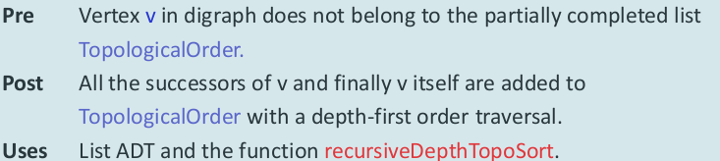
Topological Order
<void> recursiveDepthTopoSort (val v <VertexType>,
ref TopologicalOrder <List>)
Idea:
• Performs the recursion, based on the outline for the general function traverse.
• First, places all the successors of v into their positions in the topological order.
• Then, places v into the order.

Slide 42
Topological Order
<void> recursiveDepthTopoSort (val v <VertexType>,
ref TopologicalOrder <List>)
1. mark(v)
2. loop (more vertex w adjacent to v)
1. if (vertex w is unmarked)
1. recursiveDepthTopoSort(w, TopologicalOrder)
3. TopologicalOrder.Insert(0, v)
End recursiveDepthTopoSort

Slide 43
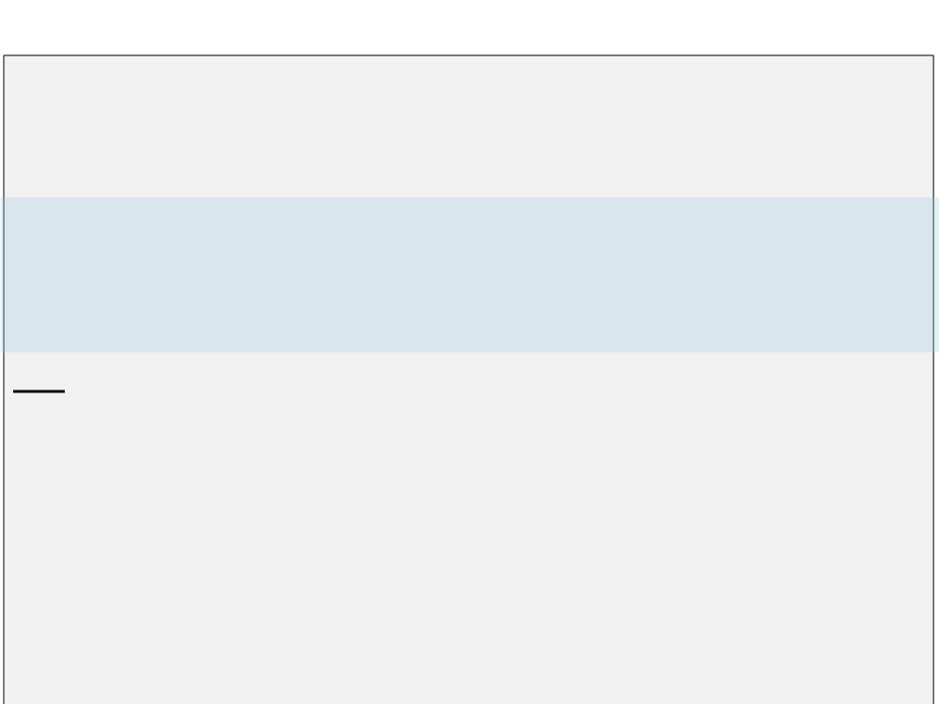
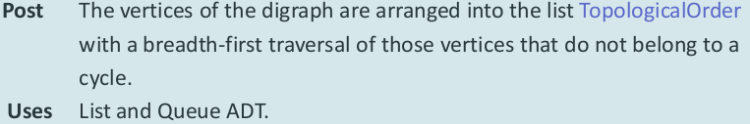
Topological Order
<void> BreadthTopoSort (ref TopologicalOrder <List>)
Traverses the digraph in depth-first order and made a list of topological order of digraph's vertices.
Idea:
• Starts by finding the vertices that are not successors of any other vertex.
• Places these vertices into a queue of vertices to be visited.
• As each vertex is visited, it is removed from the queue and placed in the next available position in the topological order (starting at the beginning).
• Reduces the indegree of its successors by 1.
• The vertex having the zero value indegree is ready to processed and is places into the queue.

Slide 44
Topological Order

Slide 45
<void> BreadthTopoSort (ref TopologicalOrder <List>)
1. TopologicalOrder.clear()
2. queueObj <Queue>
3. loop (more vertex v in digraph)
1. if (indegree of v = 0)
1. queueObj.EnQueue(v)
4. loop (NOT queueObj.isEmpty())
1. queueObj.QueueFront(v)
2. queueObj.DeQueue()
3. TopologicalOrder.Insert(TopologicalOrder.size(), v)
4. loop (more vertex w adjacent to v)
1. decrease the indegree of w by 1
2. if (indegree of w = 0)
1. queueObj.EnQueue(w)
End BreadthTopoSort

Slide 46
Shortest Paths
• Given a directed graph in which each edge has a nonnegative weight.
• Find a path of least total weight from a given vertex, called the source, to every other vertex in the graph.
• A greedy algorithm of Shortest Paths: Dijkstra's algorithm (1959).

Slide 47
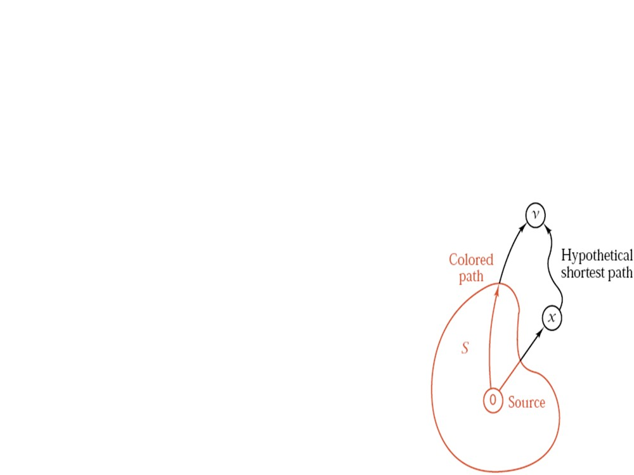
Dijkstra's algorithm
▪ Let tree is the subgraph contains the shotest paths from the source vertex to all other vertices.
▪ At first, add the source vertex to the tree. ▪ Loop until all vertices are in the tree:
• Consider the adjacent vertices of the vertices already in the tree.
• Examine all the paths from those adjacent vertices to the source vertex.
• Select the shortest path and insert the
corresponding adjacent vertex into the tree.

Slide 48

Dijkstra's algorithm in detail
• S: Set of vertices whose closest distances to the source are known.
• Add one vertex to S at each stage.
• For each vertex v, maintain the distance from the source to v, along a path all of whose vertices are in S, except possibly the last one.
• To determine what vertex to add to S at each
step, apply the greedy criterion of choosing the vertex v with the smallest distance.
• Add v to S.
• Update distance from the source for all w not in S, if the path through v and then directly to w is shorter than the previously recorded distance to w.

Slide 49

Dijkstra's algorithm

Slide 50

Dijkstra's algorithm

Slide 51

Dijkstra's algorithm

Slide 52

Dijkstra's algorithm

Slide 53

Dijkstra's algorithm

Slide 54

Dijkstra's algorithm

Slide 55

Dijkstra's algorithm
<void> ShortestPath (val source <VertexType>,
ref listOfShortestPath <List of <DistanceNode>>)
Finds the shortest paths from source to all other vertices in digraph.
DistanceNode
destination <VertexType> distance <int>
End DistanceNode

Slide 56

// ShortestPath
1. listOfShortestPath.clear()
2. Add source to set S
3. loop (more vertex v in digraph) // Initiate all distances from source to v
1. distanceNode.destination = v
2. distanceNode.distance = weight of edge(source, v) // = infinity if
// edge(source,v) isn't in digraph.
3. listOfShortestPath.Insert(distanceNode)
4. loop (more vertex not in S) // Add one vertex v to S on each step.
1. minWeight = infinity
// Choose vertex v with smallest distance.
2. loop (more vertex w not in S)
1. Find the distance x from source to w in listOfShortestPath
2. if (x < minWeight)
DistanceNode
1. v = w
destination <VertexType>
2. minWeight = x
distance <int>
3. Add v to S.
End DistanceNode

Slide 57
// ShortestPath (continue)
4. loop (more vertex w not in S) // Update distances from source // to all w not in S
1. Find the distance x from source to w in listOfShortestPath
2. if ( (minWeight + weight of edge from v to w) < x )
1. Update distance from source to w in listOfShortestPath to (minWeight + weight of edge from v to w) End ShortestPath
DistanceNode
destination <VertexType> distance <int>
End DistanceNode

Slide 58
Another example of Shortest Paths
Select the adjacent vertex having minimum path to the source vertex

Slide 60

Minimum spanning tree
DEFINITION:
Spanning tree: tree that contains all of the vertices in a connected graph.
Minimum spanning tree: spanning tree such that the sum of the weights of its edges is minimal.

Slide 61

Spanning Trees
Two spanning trees in a network

Slide 62
A greedy Algorithm: Minimum Spanning Tree
➢ Shortest path algorithm in a connected graph found an its spanning tree.
➢ What is the algorithm finding the minimum spanning tree?
➢ A small change to shortest path algorithm can find the minimum spanning tree, that is Prim's algorithm since 1957.

Slide 63
Prim's algorithm
▪ Let tree is the minimum spanning tree. ▪ At first, add one vertex to the tree. ▪ Loop until all vertices are in the tree:
• Consider the adjacent vertices of the vertices already in the tree.
• Examine all the edges from each vertices already in the tree to those adjacent vertices.
• Select the smallest edge and insert the corresponding adjacent vertex into the tree.

Slide 64
Prim's algorithm in detail
• Let S is the set of vertices already in the minimum spanning tree.
• At first, add one vertex to S.
• For each vertex v not in S, maintain the distance from a vertex x to v, where x is a vertex in S and the edge(x,v) is the smallest in all edges from another vertices in S to v (this edge(x,v) is called the distance from S to v). As usual, all edges not being in graph have infinity value.
• To determine what vertex to add to S at each step, apply the greedy criterion of choosing the vertex v with the smallest distance from S.
• Add v to S.
• Update distances from S to all vertices v not in S if they are smaller
than the previously recorded distances.

Slide 65

Prim's algorithm
Select the adjacent vertex having minimum edge to the vertices
already in the tree.

Slide 66


Prim's algorithm
<void> MinimumSpanningTree (val source <VertexType>, ref tree <Graph>)
Finds the minimum spanning tree of a connected component of the original graph that contains vertex source.
Uses local variables:
• Set S
DistanceNode
vertexFrom <VertexType> vertexTo <VertexType> distance <WeightType> End DistanceNode
• listOfDistanceNode
• continue <boolean>

Slide 67

1. tree.clear()
2. tree.InsertVertex(source)
3. Add source to set S
4. listOfDistanceNode.clear()
5. distanceNode.vertexFrom = source
6. loop (more vertex v in graph)//Initiate all distances from source to v
1. distanceNode.vertexTo = v
2. distanceNode.distance = weight of edge(source, v) // = infinity if // edge(source,v) isn't in graph.
3. listOfDistanceNode.Insert(distanceNode)
DistanceNode
vertexFrom <VertexType> vertexTo <VertexType> distance <WeightType> End DistanceNode

Slide 68

7. continue = TRUE
8. loop (more vertex not in S) and (continue) //Add one vertex to S on // each step
1. minWeight = infinity //Choose vertex v with smallest distance toS
2. loop (more vertex w not in S)
1. Find the node in listOfDistanceNode with vertexTo is w
2. if (node.distance < minWeight)
1. v = w
2. minWeight = node.distance
DistanceNode
vertexFrom <VertexType> vertexTo <VertexType> distance <WeightType> End DistanceNode

Slide 69

3. if (minWeight < infinity)
1. Add v to S.
2. tree.InsertVertex(v)
3. tree.InsertEdge(v,w)
4. loop (more vertex w not in S) // Update distances from v to // all w not in S if they are smaller than the
// previously recorded distances in listOfDistanceNode
1. Find the node in listOfDistanceNode with vertexTo is w
2. if ( node.distance > weight of edge(v,w) )
1. node.vertexFrom = v
2. node.distance = weight of edge(v,w) )
3.
Replace this node with its old node in listOfDistance
4. else
DistanceNode
1. continue = FALSE
vertexFrom <VertexType>
End MinimumSpanningTree
vertexTo <VertexType> distance <WeightType>
End DistanceNode

Slide 70

Maximum flows

Slide 71

Maximum flows

Slide 72

Maximum flows

Slide 73

Maximum flows

Slide 74

Maximum flows

Slide 75

Matching

Slide 76

Matching

Slide 77

Matching

Slide 78

Matching

Slide 79

Matching

Slide 80

Graph coloring

Slide 81

Graph coloring

Slide 82

Graph coloring

Slide 83

Graph coloring

Slide 84

Graph coloring

